Slide 1


Slide 2
FINAL YEAR PROJECT | CDRB ADJUDICATION
SDR-Based Doppler Radar
using SDR for Velocity Measurement
Advisor:
ASSISTANT PROFESSOR MOHAMMAD MUSTAQIM
GROUP MEMBERS:
S/LT BILAL PN
S/LT SANAULLAH PN
S/LT FARHAN PN
S/LT HUZAIFA PN

Slide 3
Introduction
Radar systems are fundamental tools for detecting object motion and measuring velocity.
Traditional hardware radars are expensive, fixed-frequency, and difficult to reconfigure.
Software Defined Radio (SDR) replaces dedicated hardware with flexible, software-controlled signal processing.
The Analog Devices ADALM-PLUTO (PlutoSDR) is a low-cost, portable SDR platform operating from 325 MHz – 3.8 GHz.
This project implements a complete Doppler radar system on SDR using GNU Radio for real-time velocity estimation.
2

Slide 4
Problem Statement
Conventional radar systems for velocity measurement are costly and hardware-dependent; a flexible, low-cost SDR-based Doppler radar is needed for accurate real-time velocity measurement without dedicated RF hardware.
💸 Cost
🔒 Inflexibility
📐 Complexity
Dedicated radar ICs cost thousands of dollars
Fixed-frequency hardware cannot be reprogrammed
Separate TX/RX chains increase system complexity
3

Slide 5
Proposed Solution
Use SDR as a low-cost, software-reconfigurable platform to transmit a CW signal and capture the Doppler-shifted echo for real-time velocity computation via GNU Radio.
💡 Low-Cost Hardware
🖥 Software-Defined Processing
📡 Doppler Velocity Engine
SDR
No custom RF PCB needed
USB-powered portable device
GNU Radio
Real-time signal processing
Reconfigurable frequency & gain
CW signal @ 2.4 GHz
FFT-based frequency shift detection
Velocity computed from fd = 2v·fc/c
4

Slide 6
Doppler Effect – Principle
fd = 2 · v · fc / c
fd
→ Doppler frequency shift (Hz)
v
→ Target radial velocity (m/s)
fc
→ Carrier frequency (Hz)
c
→ Speed of light = 3×10⁸ m/s
How It Works
Radar transmits a continuous wave (CW) at fc = 2.4 GHz
Moving target reflects the signal — reflected wave has a shifted frequency
Frequency difference fd is proportional to velocity v
Approaching targets → positive fd | Receding targets → negative fd
5

Slide 7
System Block Diagram
Target
Transmitted CW Signal →
GNU Radio
(Host PC)
PlutoSDR
TX
TX Antenna
(Dipole)
← Doppler-shifted Echo
FFT &
Velocity Calculation
PlutoSDR
RX
RX Antenna
(Dipole)
6

Slide 8
Signal Processing Flow
01
CW Generation
02
Signal Transmission
GNU Radio generates a 2.4 GHz CW tone via SDR TX
Antenna radiates the signal; wave propagates to moving target
03
Echo Reception
04
Mixing / Demodulation
SDR RX captures reflected signal
Received signal is down-converted; Doppler shift appears as low-frequency tone
05
FFT Analysis
06
Velocity Computation
Fast Fourier Transform applied
v = fd × c / (2 × fc) → displayed in real time on GNU Radio
7

Slide 9
SDR Platform – PLUTO (PlutoSDR)
Parameter | Specification
RF Frequency Range | 325 MHz – 3.8 GHz
Bandwidth | Up to 56 MHz
ADC / DAC Resolution | 12-bit
Interface | USB 2.0 (High-Speed)
Transceiver IC | Analog Devices AD9361
Carrier Freq (Used) | 2.4 GHz (ISM Band)
TX Power | Up to +7 dBm
GNU Radio Support | gr-iio PlutoSDR blocks
Why PlutoSDR?
Full-duplex transceiver — simultaneous TX and RX
Wide tuning range — suitable for multiple radar bands
Native GNU Radio support (gr-iio)
Low cost — ideal for academic prototyping
Compact form factor — portable deployment
8

Slide 10
System Specifications
Parameter | Value | Note
Carrier Frequency | 2.4 GHz | ISM band – license-free
Waveform Type | CW (Continuous Wave) | Simplest Doppler radar waveform
Sampling Rate | 1 MSPS | PlutoSDR baseband rate
FFT Size | 1024 points | Frequency resolution ~977 Hz
Doppler Resolution | ~0.06 m/s | fd_res × c / (2 × fc)
Max Measurable Velocity | ~70 m/s | Limited by sampling rate
Antenna Type | Dipole (2.4 GHz) | ~2 dBi gain, omnidirectional
TX-RX Separation | ≥ 0.5 m | Reduce self-interference
Processing Platform | GNU Radio 3.10 | gr-iio PlutoSDR blocks + Python
9

Slide 11
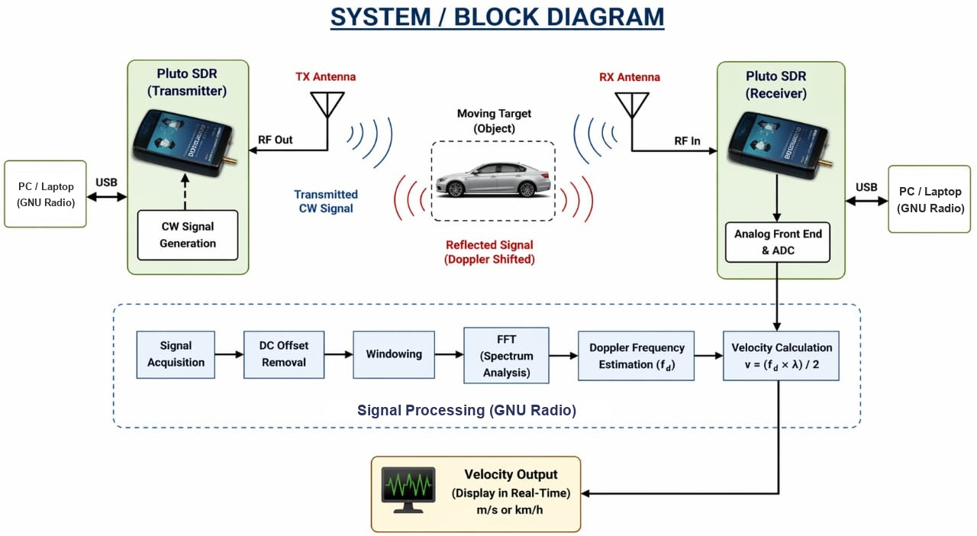
Hardware Setup & Circuit Diagram
10

Slide 12
TENTATIVE BUDGET
COMPONENTS | COST
Pluto SDR Device | 85k-90k pkr
Tx/Rx Antennas (2 units) | 5k-8k pkr
RF Components (cables, connectors) | 2k-4k pkr
Processing system (laptop) | 00 pkr (existing)
Software tools (GNU Radio) | 00 pkr ( free for student)
Miscellaneous | 4k-5k pkr (PCB casting)
Total | 96k-107k pkr
11

Slide 13
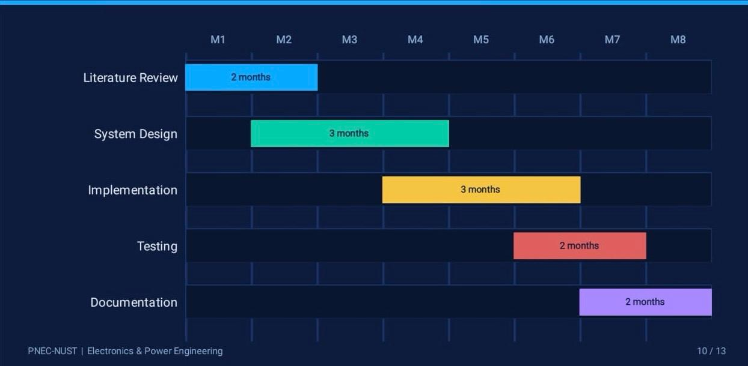
GANTT CHART - PROJECT TIMELINE
12

Slide 14
CONCLUSION
A fully functional SDR-based Doppler radar — built and validated.
✅
Successfully implemented Doppler radar using PlutoSDR — no custom RF hardware required
✅
This system effectively measures velocity using doppler frequency shift in real time through software based signal processing using GNU Radio
✅
The project demonstrate practical use of software defined radio in modern radar application with scope for future improvements such as range detection and higher accuracy
13

Slide 15


